Slide 1
Git / GitHub for Version Control and Collaborations
Colette Ward
NSERC Visiting Fellow
Great Lakes Laboratory for Fisheries & Aquatic Sciences
Fisheries & Oceans Canada
8 April 2020

Slide 2
stockRecruit_final.R
stockRecruit_final_A.R
stockRecruit_UseThisOne.R
stockRecruit_finalFinal_SKEdits.R
stockRecruit_finalFinal_MJEdits.R
stockRecruit_finalFinal.R

Slide 3
The Fundamentals
What is Git/GitHub?
Creating and cloning a new repository to your computer
GitHub workflow: Pull -> Stage -> Commit -> Push
Stuff you hope you never need to use
Merge conflicts
The fun stuff
Branches
Collaboration do’s and don’ts
GitHub features

Slide 4
What is GitHub?
Git: local version control
GitHub: a website that stores your versioned files remotely

Slide 5
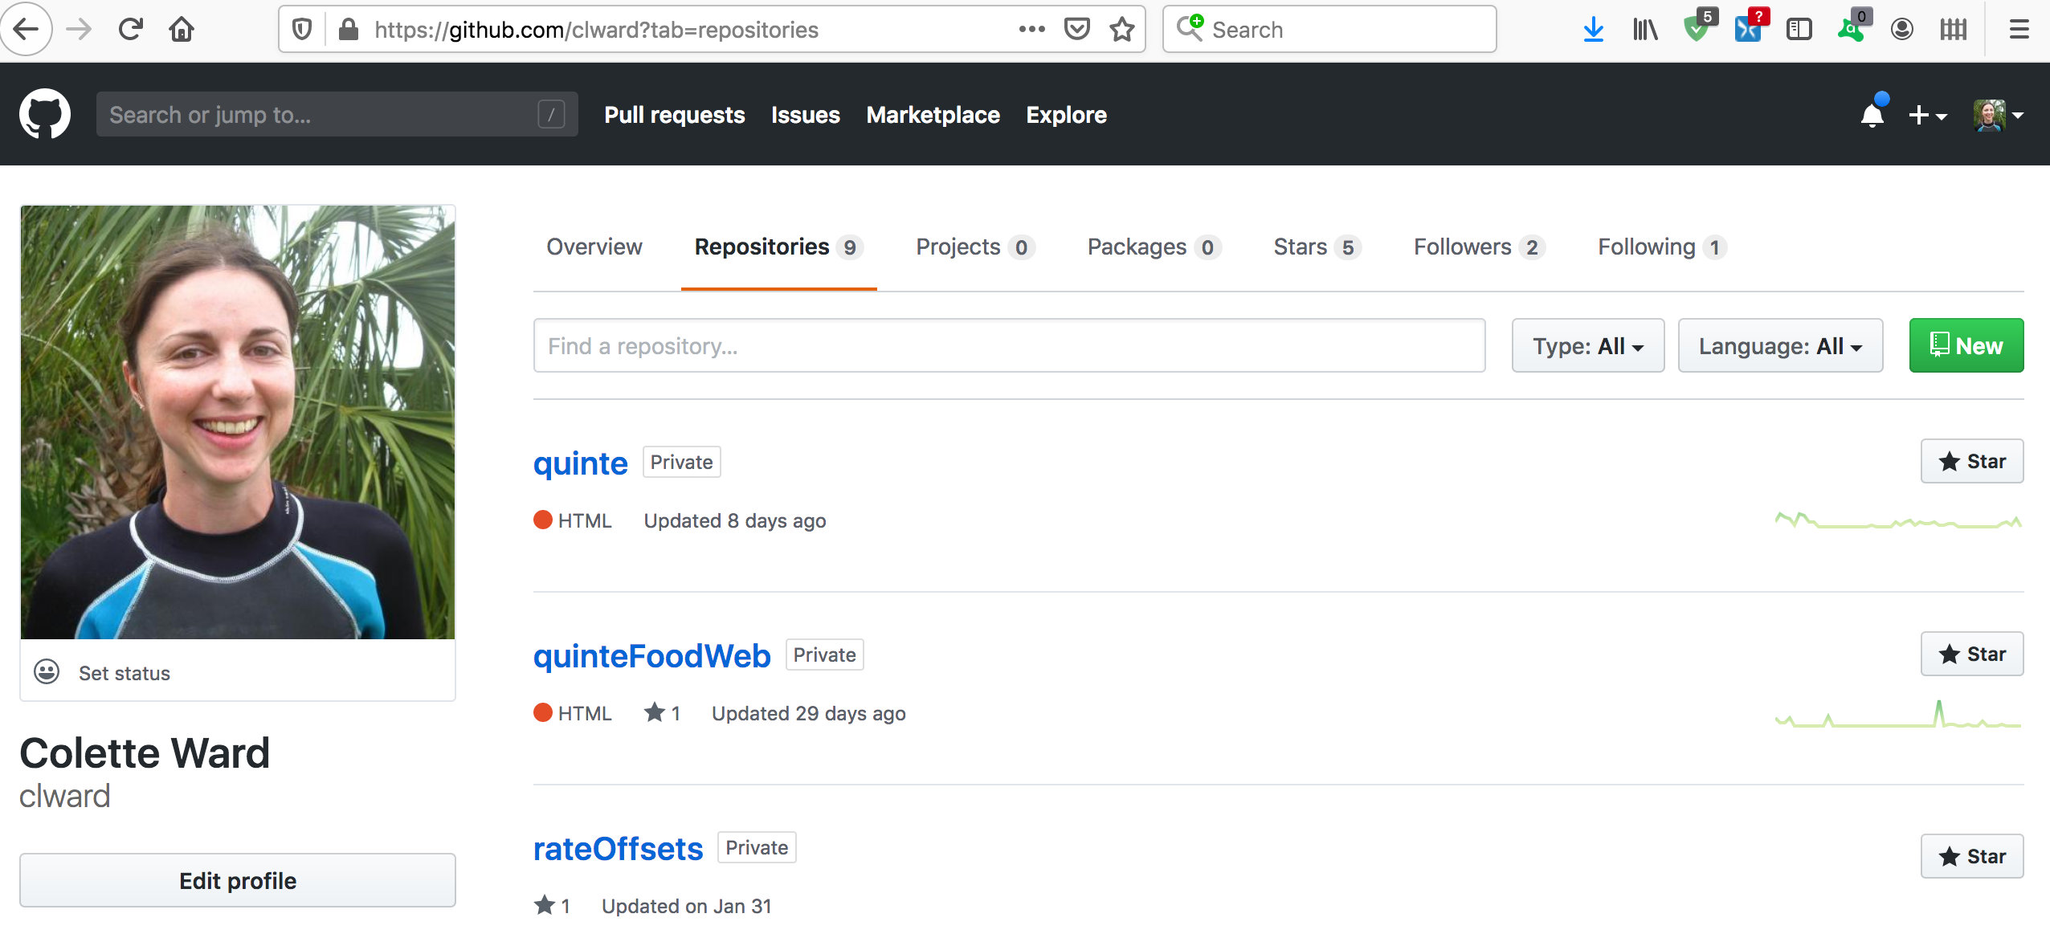


Origin
Local

Slide 6



Origin
Local
Local
Local

Slide 7
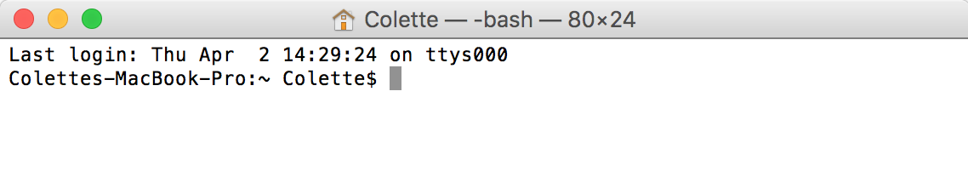
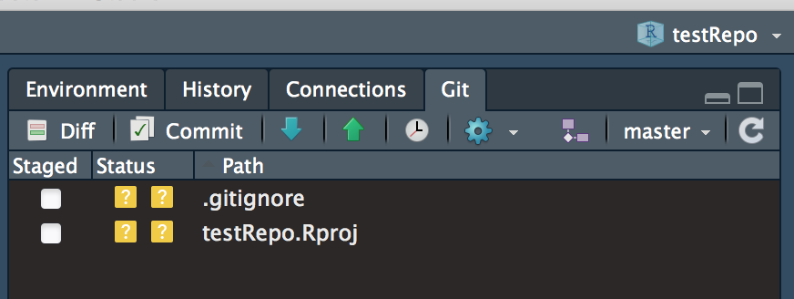
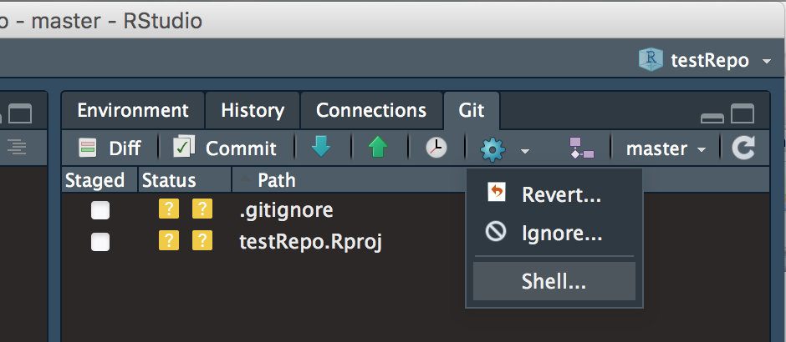
Interface with Git/GitHub using the Terminal or RStudio
Or open the terminal from RStudio:

Slide 8
Problems detecting Git from RStudio?
https://happygitwithr.com/rstudio-see-git.html
https://happygitwithr.com/troubleshooting.html
You must be in a project to see the Git tab

Slide 9
Configure your username and email
Git tab -> More -> Shell
git config --global user.email your_email@example.com
(must be the email associated with your GitHub account)
git config --global user.name ‘Your GitHub Username’ (You can set different usernames for each machine you work from if that’s useful for you)

Slide 10
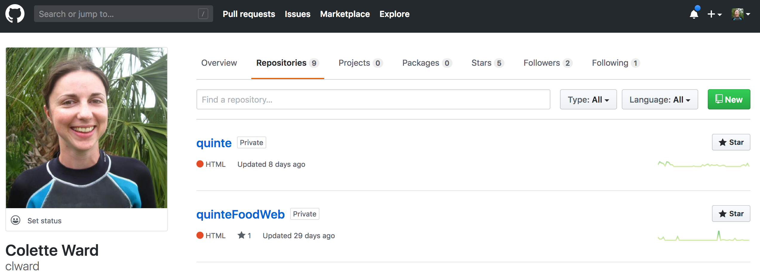
Creating a New Repository
*In RStudio, relies on the ‘Projects’ feature

Slide 11
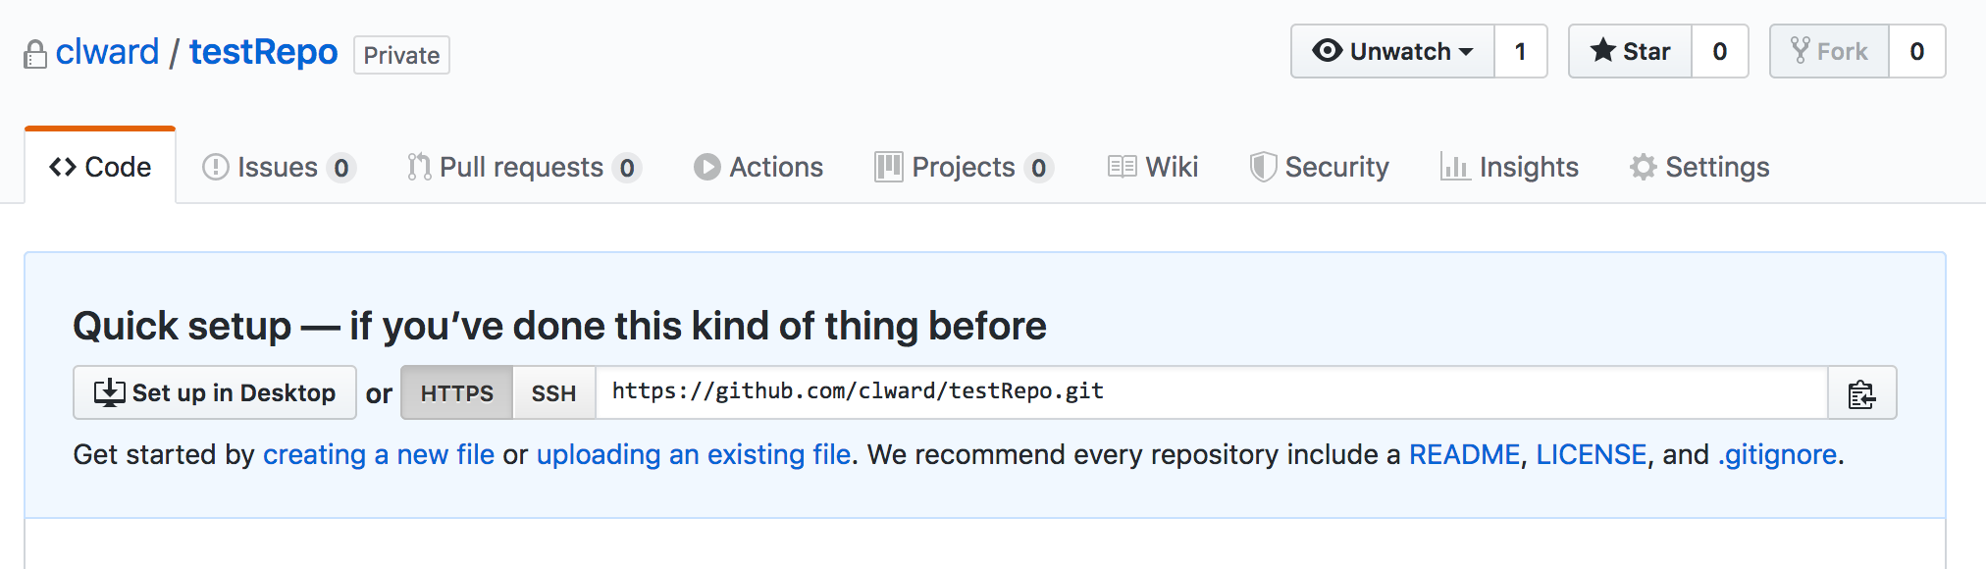
Cloning a new repository from GitHub to your local machine

Slide 12
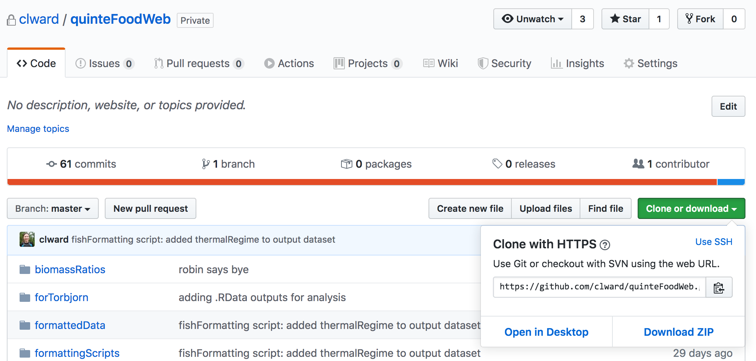
Cloning an existing repository from GitHub to your local machine

Slide 13
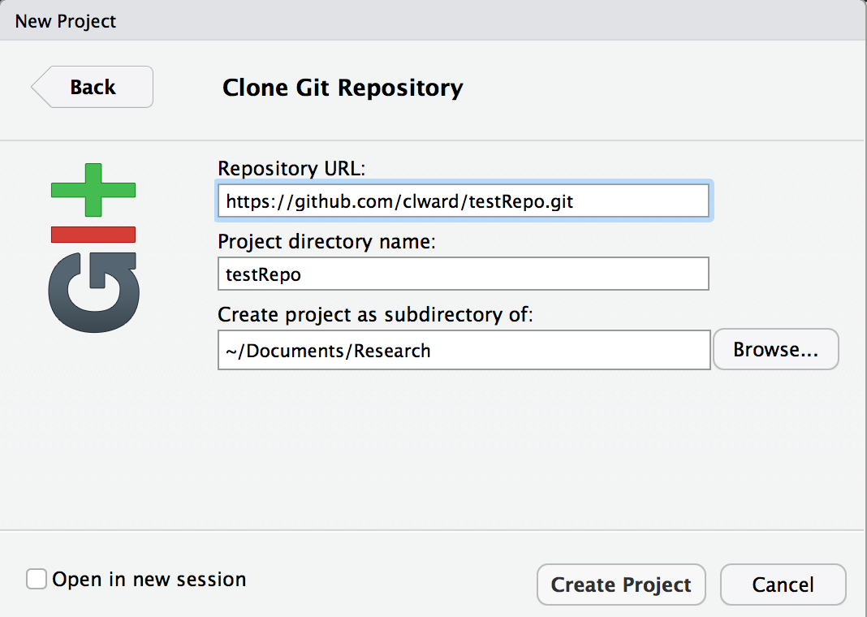
Cloning a repository from GitHub to your local machine
In RStudio:
File -> New Project -> Version Control -> Git

Slide 14
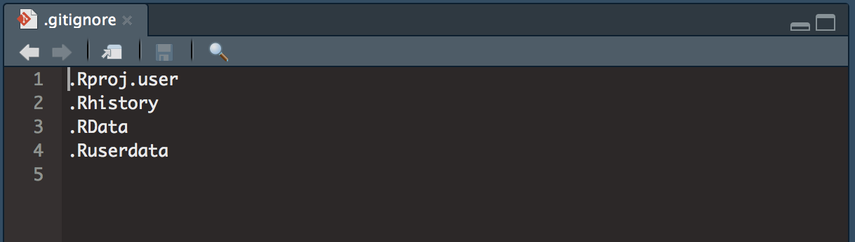
Make sure these are in the .gitignore file

Slide 15
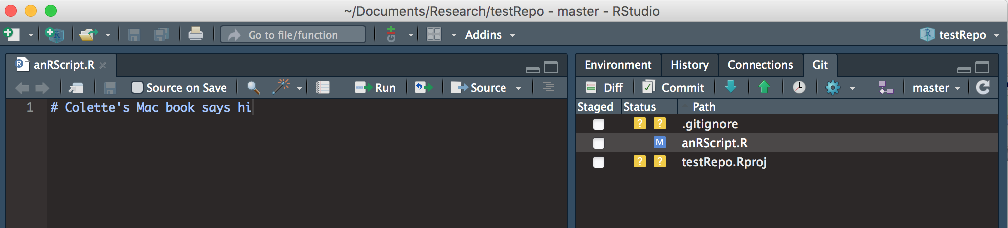
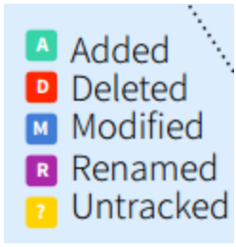
Make some changes to your repo

Slide 16
Pull -> Stage -> Commit -> Push 1. Pull

Slide 17
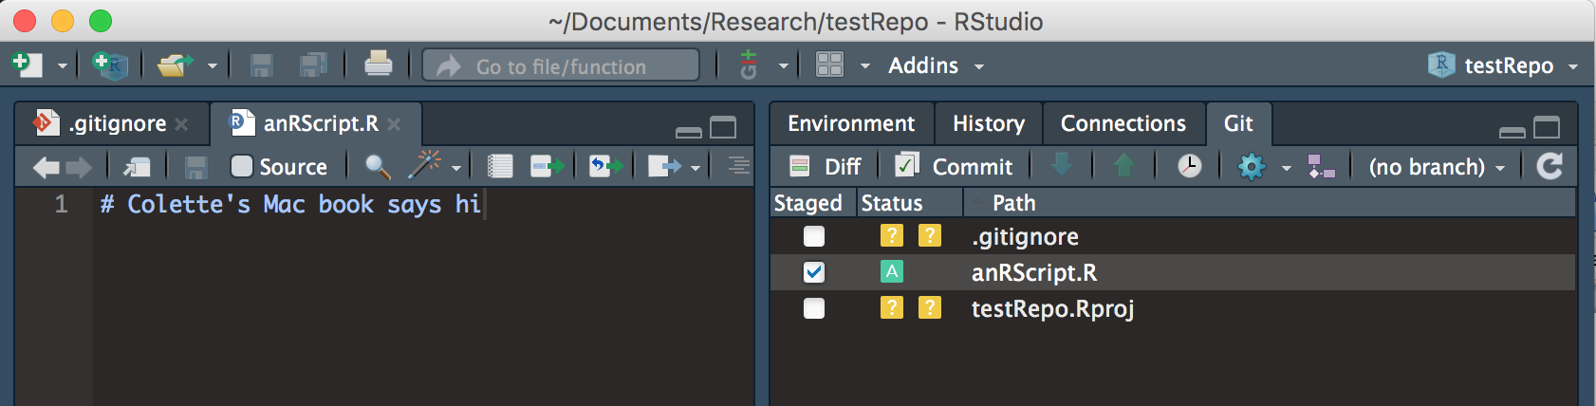
Pull -> Stage -> Commit -> Push 2. Stage

Slide 18
Pull -> Stage -> Commit -> Push 3. Commit
Commit = version control! A snapshot of the entire repository at time t

Slide 19
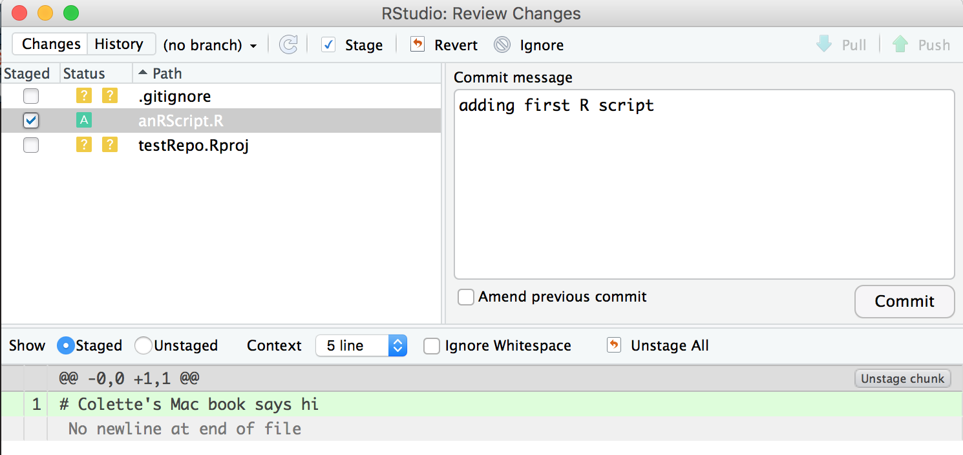
Pull -> Stage -> Commit -> Push 3. Commit

Slide 20
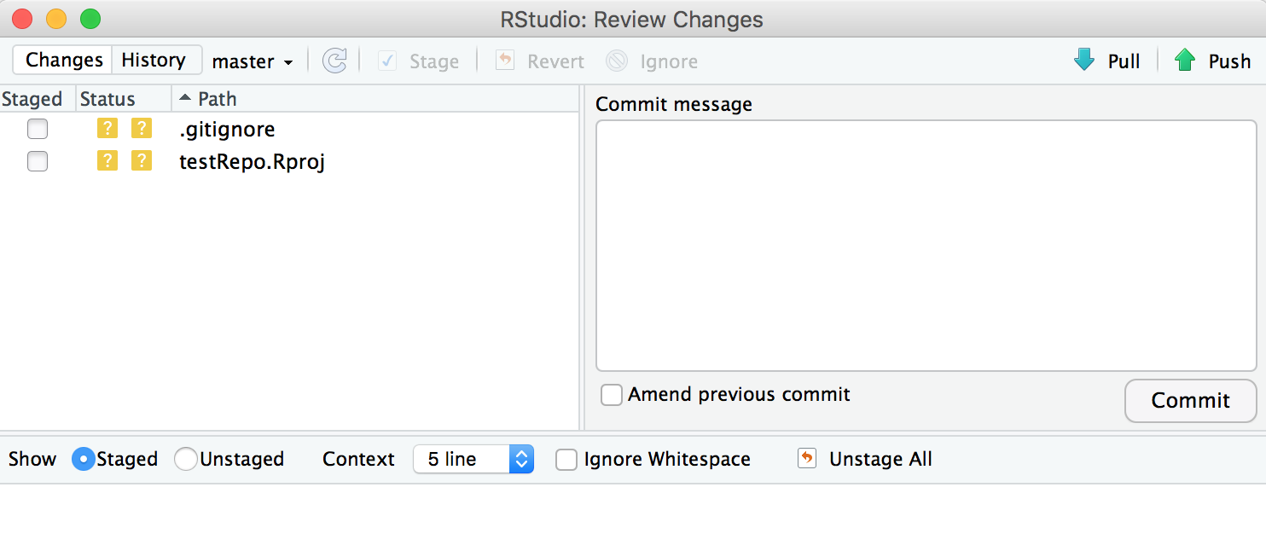
Pull -> Stage -> Commit -> Push 4. Push

Slide 21
PULL before you PUSH!!!

Slide 22
Good (short) reading on workflow for code/package development
https://happygitwithr.com/repeated-amend.html

Slide 23
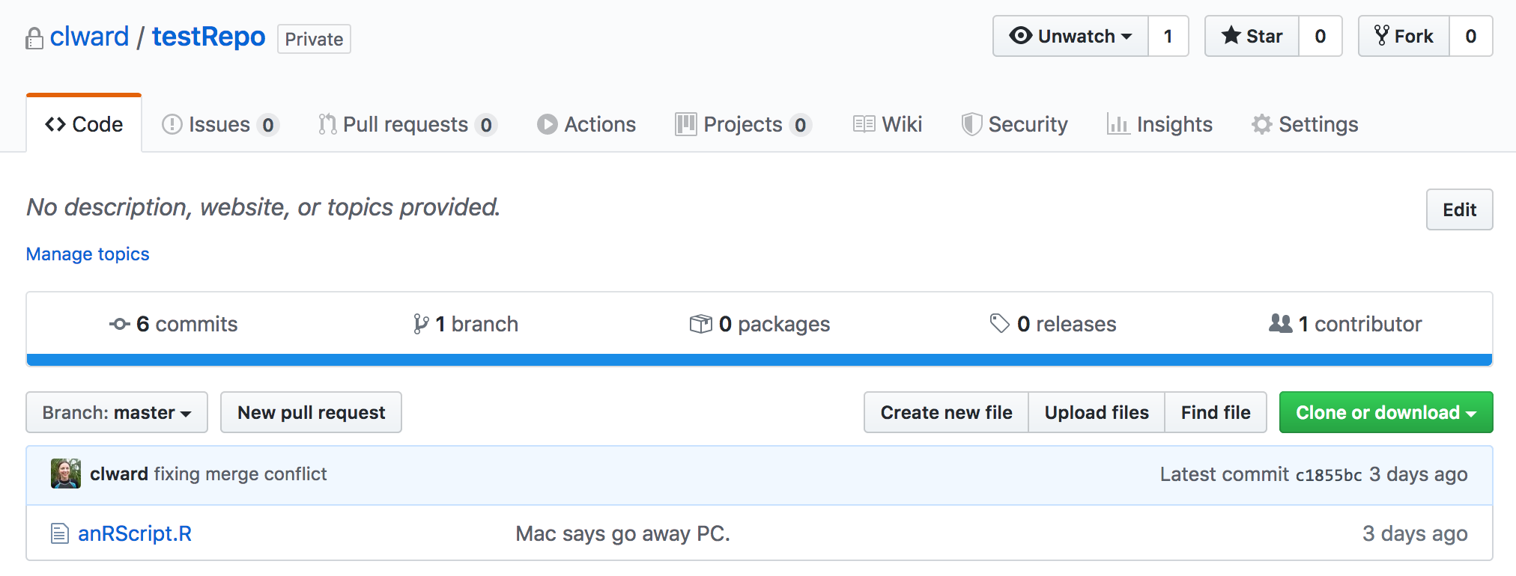
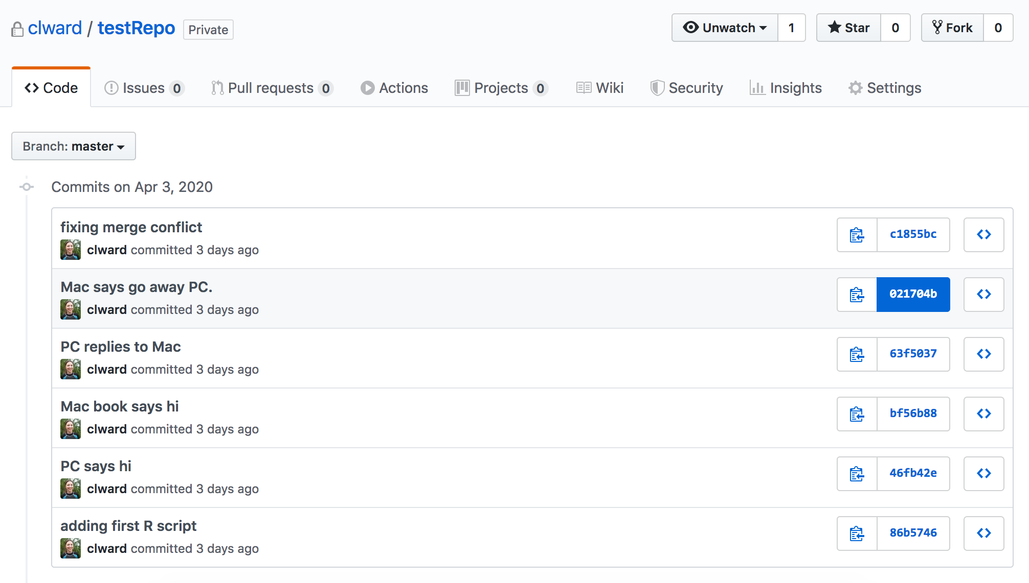
Look at commit history on GitHub
the SHA. Click to see the diff
See the state of the entire repo at this commit

Slide 24
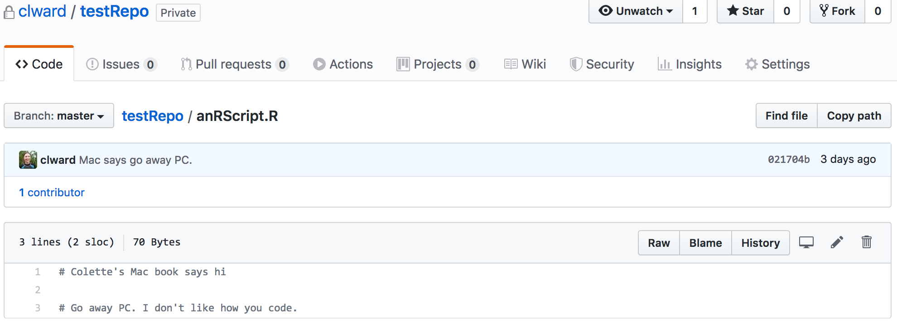
Look at commit history on GitHub
Click to see who wrote each line
Click to see commit history for this file

Slide 25
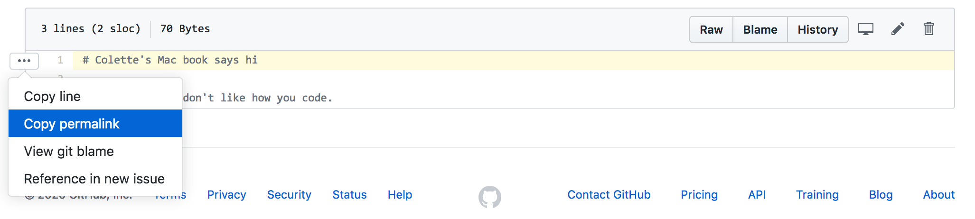
Hyperlinking to code lines
* Type “y” to get a hyperlink that includes the SHA (watch your browser URL to check), because line numbers change as your code evolveshttps://github.com/clward/testRepo/blob/c1855bc77e2a401aae7a69074e6f36ae36ae23c2/anRScript.R#L1

Slide 26
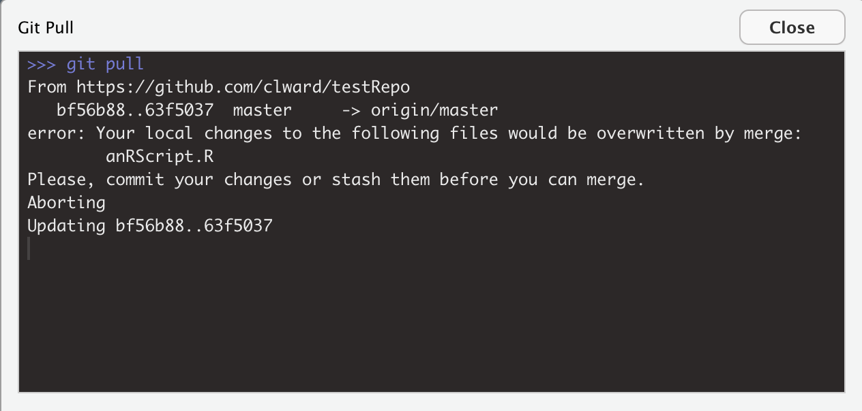
Merge conflicts
Do some local work -> Pull -> Merge conflict!
Stage & commit your local changes -> Pull
Notes:
1. Do some local work, save it, then pull. (Don’t commit yet). -> Error message, not allowed to pull.
2. Commit local changes, then pull again.

Slide 27
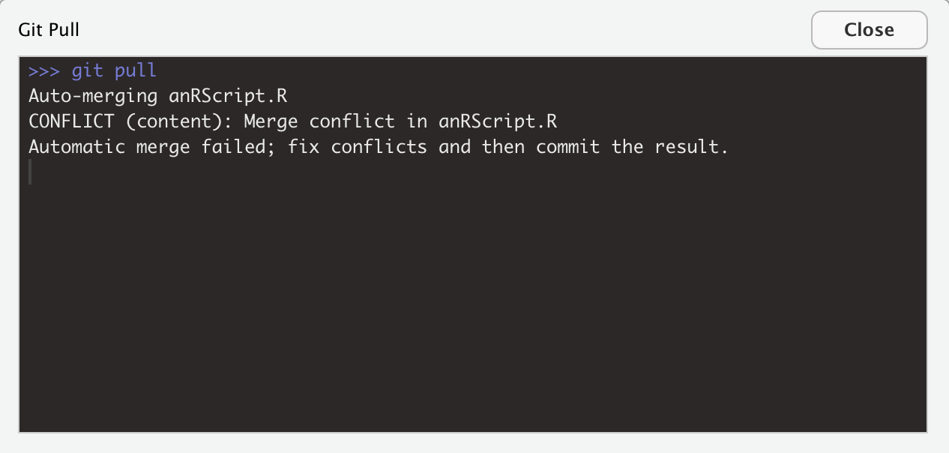
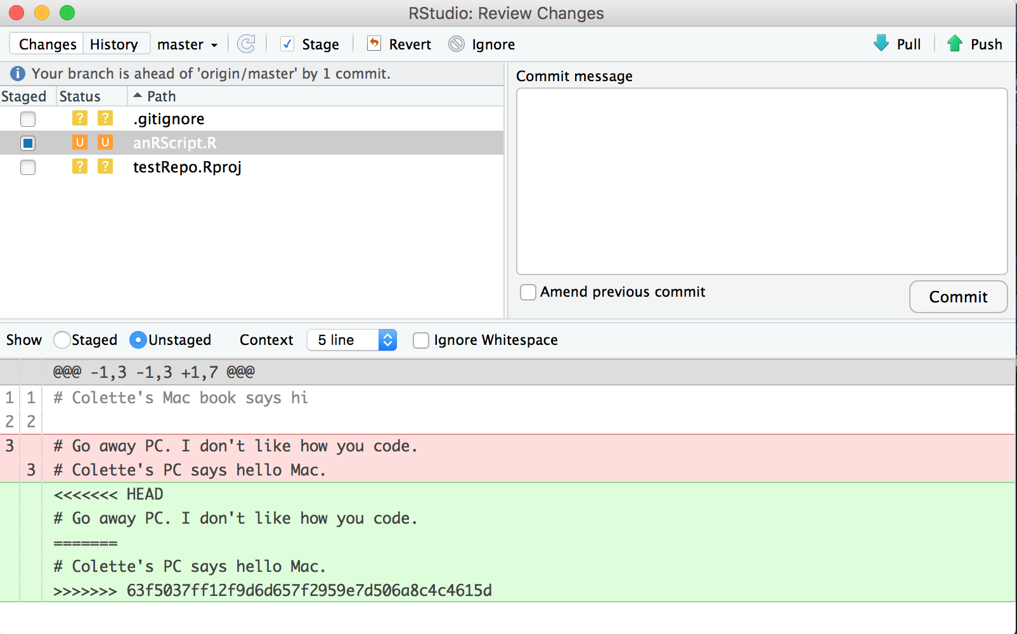
Merge conflicts
Notes:
1. Do some local work, save it, then pull. (Don’t commit yet). -> Error message, not allowed to pull.
2. Commit local changes, then pull again.

Slide 28
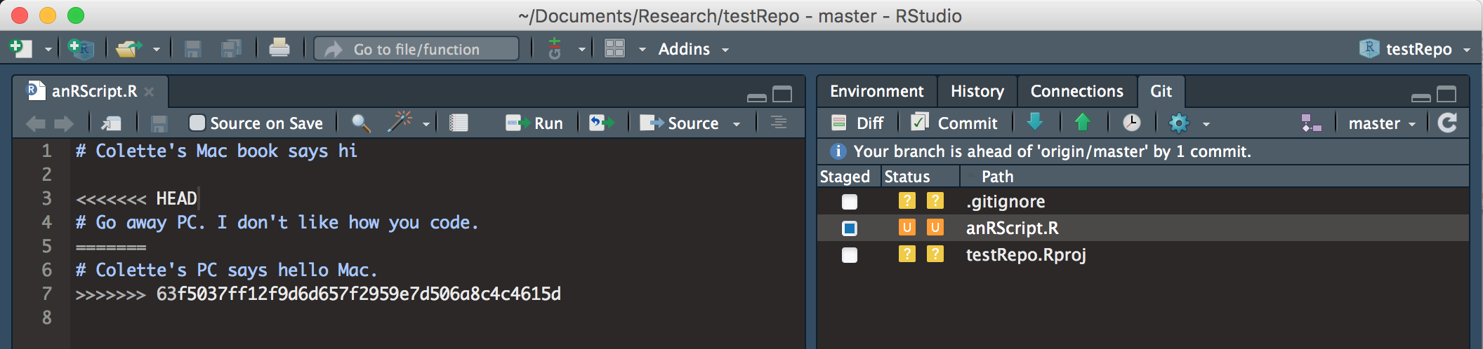
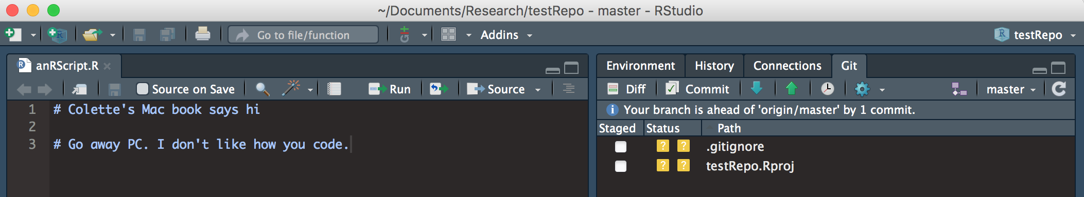
Merge conflicts
Delete what you don’t want to keep. Save.
Pull
Notes:
Fix the code -> Pull -> Error message telling you to do a git add file.R
In the terminal: git add anRScript.R, then git commit -> see message pop-up -> git commit –m “fixing merge conflict”, then git push -u origin master

Slide 29
Merge conflicts
Open the terminal:
In the terminal, type:
git add anRScript.R (stages your file)
git commit
git commit –m “your commit message here”
git push –u origin master
Notes:
To add multiple files:
git add my_new_file.R anotherFile.R aThirdFile.R

Slide 30
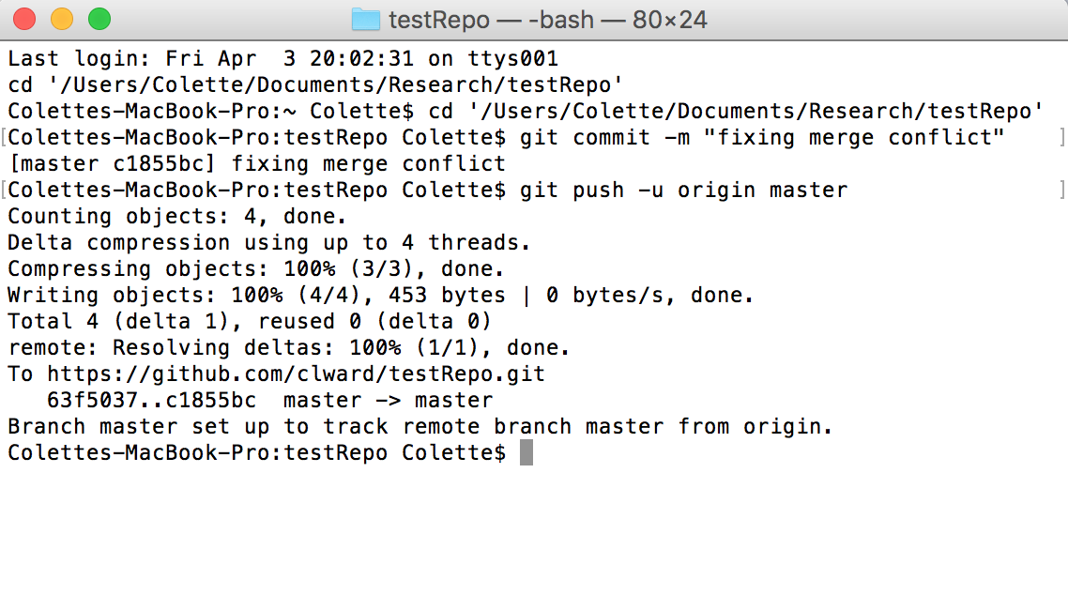
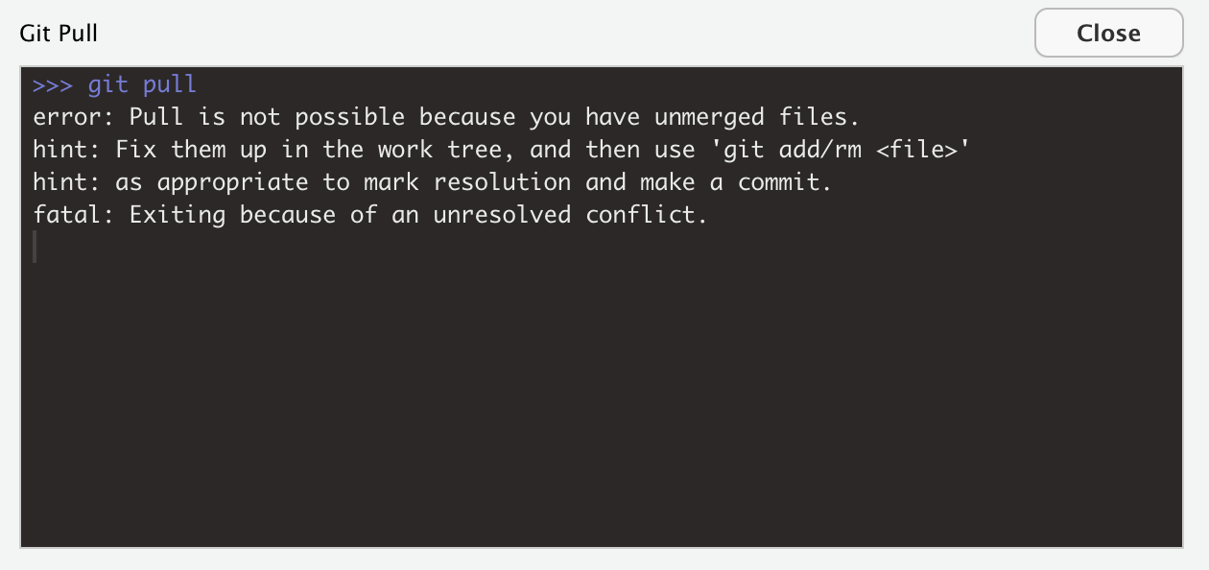
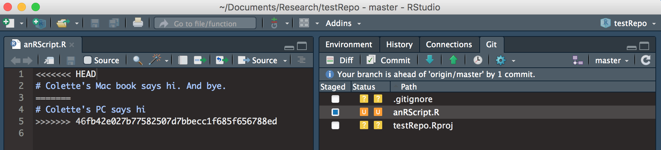
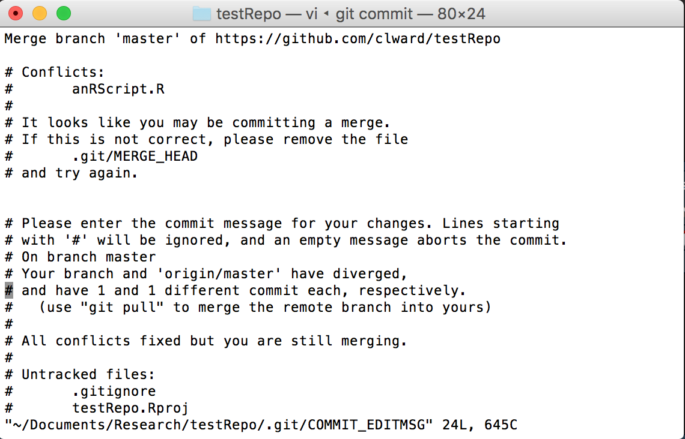
Merge conflicts
Notes:
Fix the code -> Pull -> Error message telling you to do a git add file.R
In the terminal: git add anRScript.R, then git commit -> see message pop-up -> git commit –m “fixing merge conflict”, then git push -u origin master

Slide 31
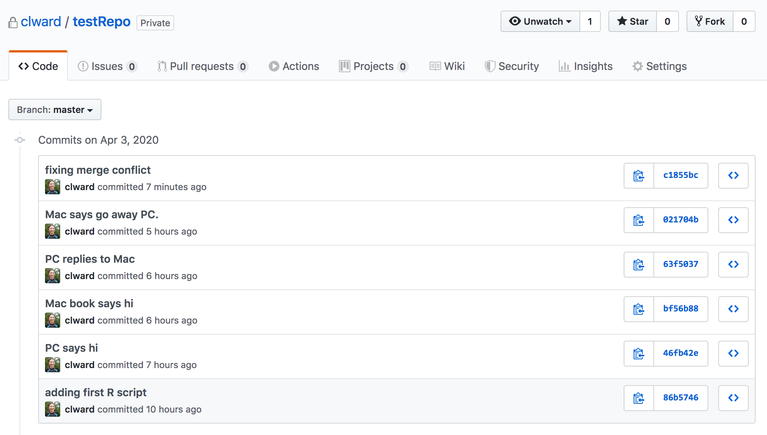

Slide 32
Avoiding Merge Conflicts
Pull often
Push often (i.e. don’t work offline for long periods)
Communicate with collaborators to avoid working simultaneously on the same file / code lines
OR
Use temporary branches for new work … not necessary but does simplify things

Slide 33
Using the command line to fix problems (these are examples – there are many strategies for fixing problems)
https://happygitwithr.com/pull-tricky.html
https://happygitwithr.com/reset.html
https://www.atlassian.com/git/tutorials/undoing-changes
HEAD refers to states of the repo:
HEAD (the last commit)
HEAD~1 (the commit before HEAD)
HEAD~2 (two commits before HEAD)
git merge –abort (cancels everything you did during the merge fix)
Overwrite ALL your local files with the latest version of the repo’s master branch, without merging (careful, you will lose all local changes!):
git fetch –all git reset --hard origin/master
Cherry-picking individual files:
git checkout --ours conflicted_file.txt (discards the remote file) or
git checkout --theirs conflicted_file.txt (discards your local file)
git add
git commit
git commit –m “your commit message here”

Slide 34
Resetting to a prior state of the repo (a) when you want to undo a LOCAL commit
git reset --soft (discards a commit but preserves local changes in your files)
git reset --hard (discards a commit AND discards local changes)
git revert (similar to git reset, but creates a new commit with the changes introduced by reverting the last commit … so you need to then commit againto undo the undesired commit)
e.g. git reset --soft HEAD~1 (resets HEAD to one commit before in the log history)
https://stackoverflow.com/a/6866485

Slide 35
Resetting to a prior state of the repo (b) when you want to reset to a commit already pushed to GitHub
1. Find the SHA of the commit you want to reset to:
2. Then follow the steps here: https://stackoverflow.com/a/4114122

Slide 36
stockRecruit_final.R
stockRecruit_final_A.R
stockRecruit_usingGammaDist.R
stockRecruit_usingGammaDist_flexInputParam.R

Slide 37
Branches
master
gammaBranch
Why branch?
- Keep a clean, hopefully perfect working version of the code
- Add/test new features without messing up the master

Slide 38
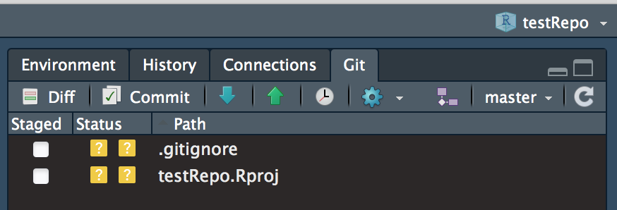
Branches
We’re on the master branch

Slide 39
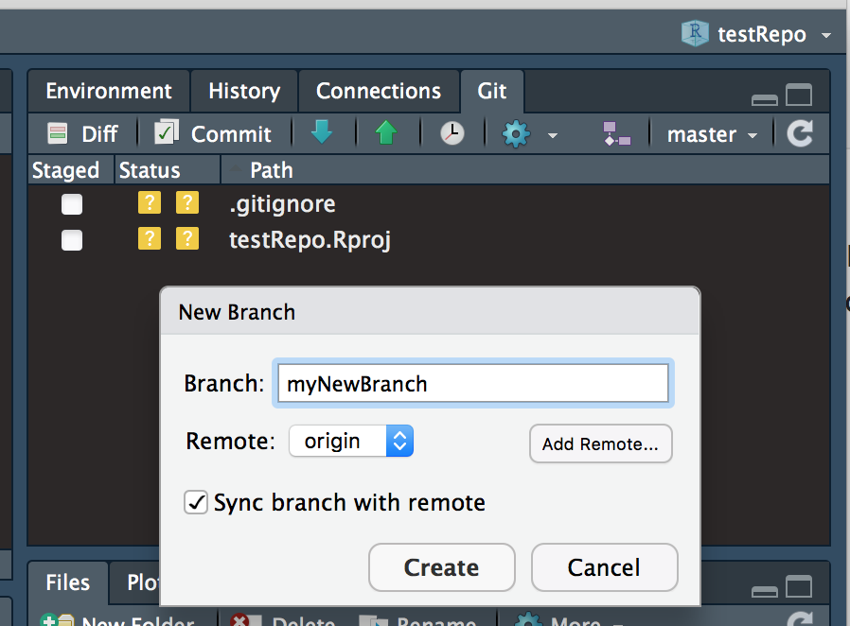
Creating a new branch
Choose which branch you are starting from
Pushes the branch to GitHub immediately

Slide 40
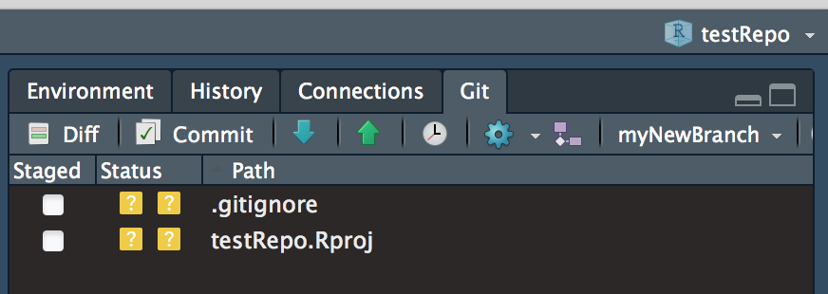
Creating a new branch
Now we’re working in myNewBranch

Slide 41
Branching: Workflow
Follow the usual workflow (Pull -> Stage -> Commit -> Push) Be sure you’re in the new branch!
To merge the branch into the master branch: Commit to the branch using the usual workflow In the terminal: git checkout master (switches you to the master branch) git pull git merge myNewBranch (merges the branch onto master) *Note you’ve only merged these branches locally!
Push to origin (GitHub)
Delete the branch: git branch -d myNewBranch
Merge conflict? See here:
https://happygitwithr.com/git-branches.html#dealing-with-conflicts

Slide 42
More about branching: https://happygitwithr.com/git-branches.html

Slide 43
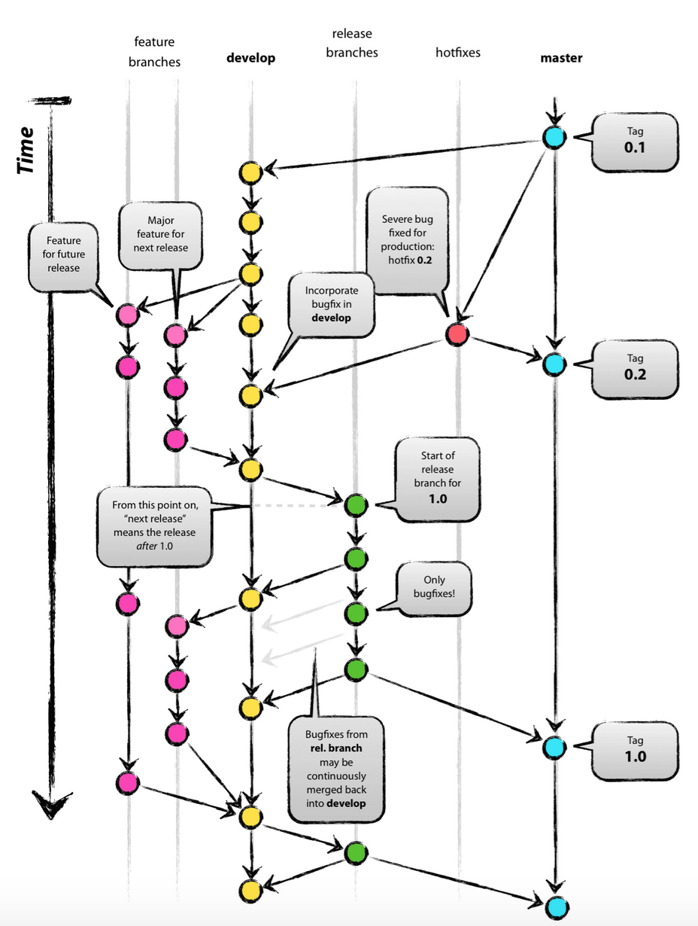
Advanced branching (e.g. for package development)
https://nvie.com/posts/a-successful-git-branching-model/

Slide 44
GitHub Etiquette for Collaborations (with Others and with Future You)
Use short file paths that make sense to a human
Don’t use special characters or spaces in file names (these can create problems between Mac/PC team members)
Don’t store large raw data files in the repo
Use short but descriptive commit messages
Commit often (locally) so that you have a safe place to fall back on when merge conflicts inevitably arise
Pull before you push! Otherwise risk overwriting a collaborator’s changes
Communicate with collaborators to avoid working simultaneously on the same file / code lines

Slide 45
More don’ts
Don’t create a repository inside another repository. Instead: (i) use a submodule: https://git-scm.com/book/en/v2/Git-Tools-Submodules or (ii) provide a path to a file (script, .Rdata object) in another repository
These can create problems with staging/committing:
Don’t store a repository / RStudio project in a folder that’s managed by Google Drive, DropBox, Microsoft OneDrive, or a network drive. Store them directly on your computer.
Don’t use spaces in directory names

Slide 46
Other features
Star, Watch, Fork others’ repositories
You can follow people on GitHub
Pull requests
Public vs private repos
Private repositories: invisible to the world but the owner can grant read, write (push), or admin access to others
GitHub Teams/Organizations

Slide 47
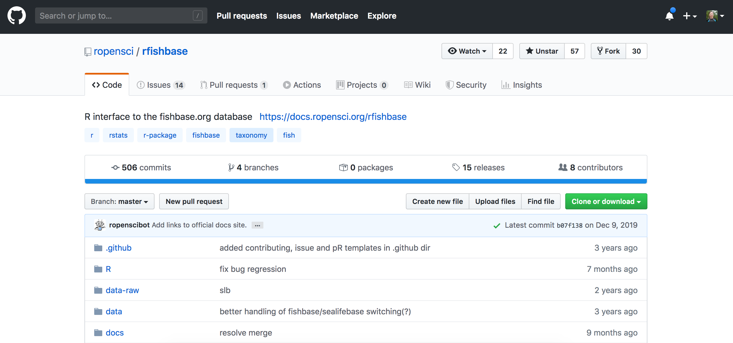
Forking (use this to pull someone else’s repo without modifying it, perhaps investigate/modify their code for your own purposes, etc.)

Slide 48
Pull requests
Asks a repo’s owner / admin team for permission to merge your changes (typically a branch). e.g. - A repo that you’ve forked - Some collaborative teams get members to work in branches and use pull requests to merge in new code. Avoids incompatibilities and merge conflicts gone bad bad bad.
Notes:
In a shared repo, you can also use this to ask a collaborator to review your code.

Slide 49
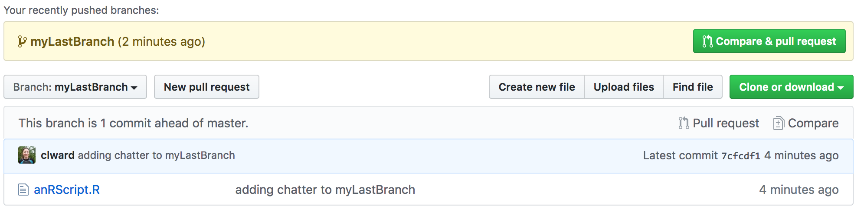
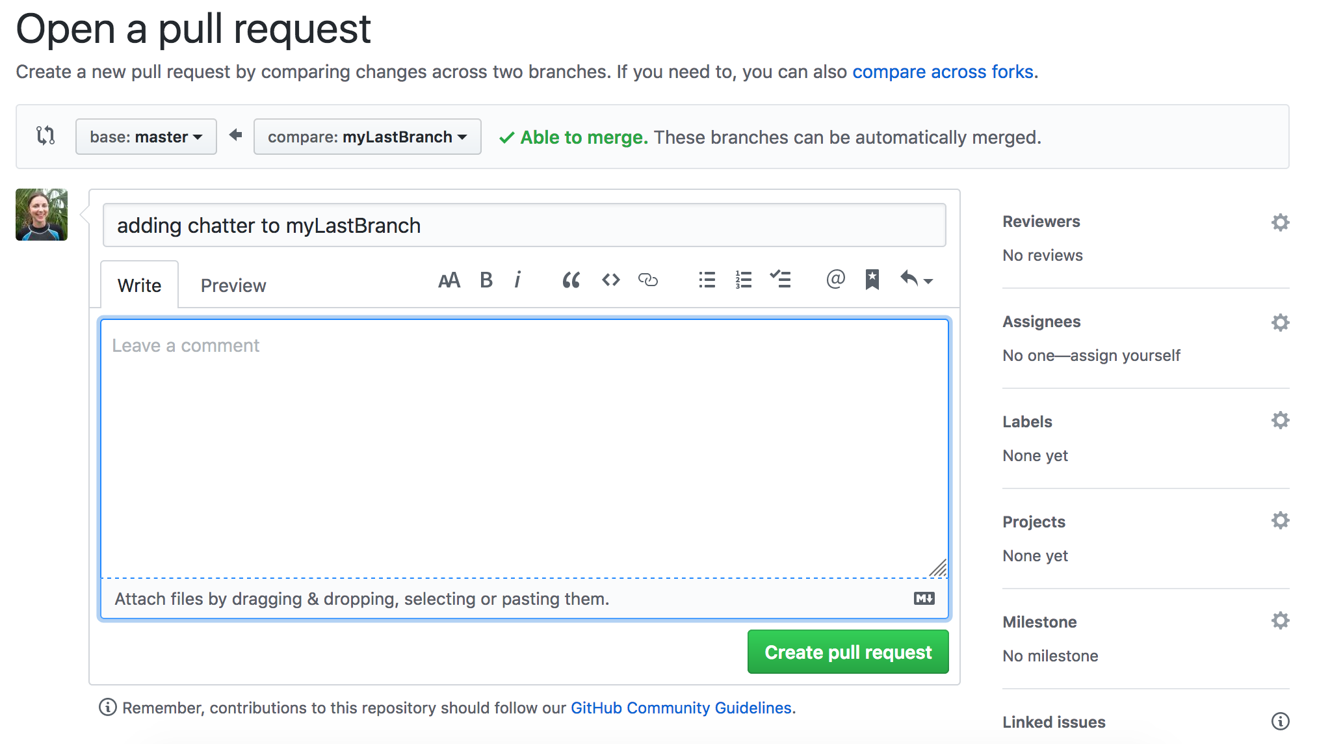
Creating a Pull Request
1. Commit your local changes in your branch.
2. Push your branch to GitHub
3.

Slide 50
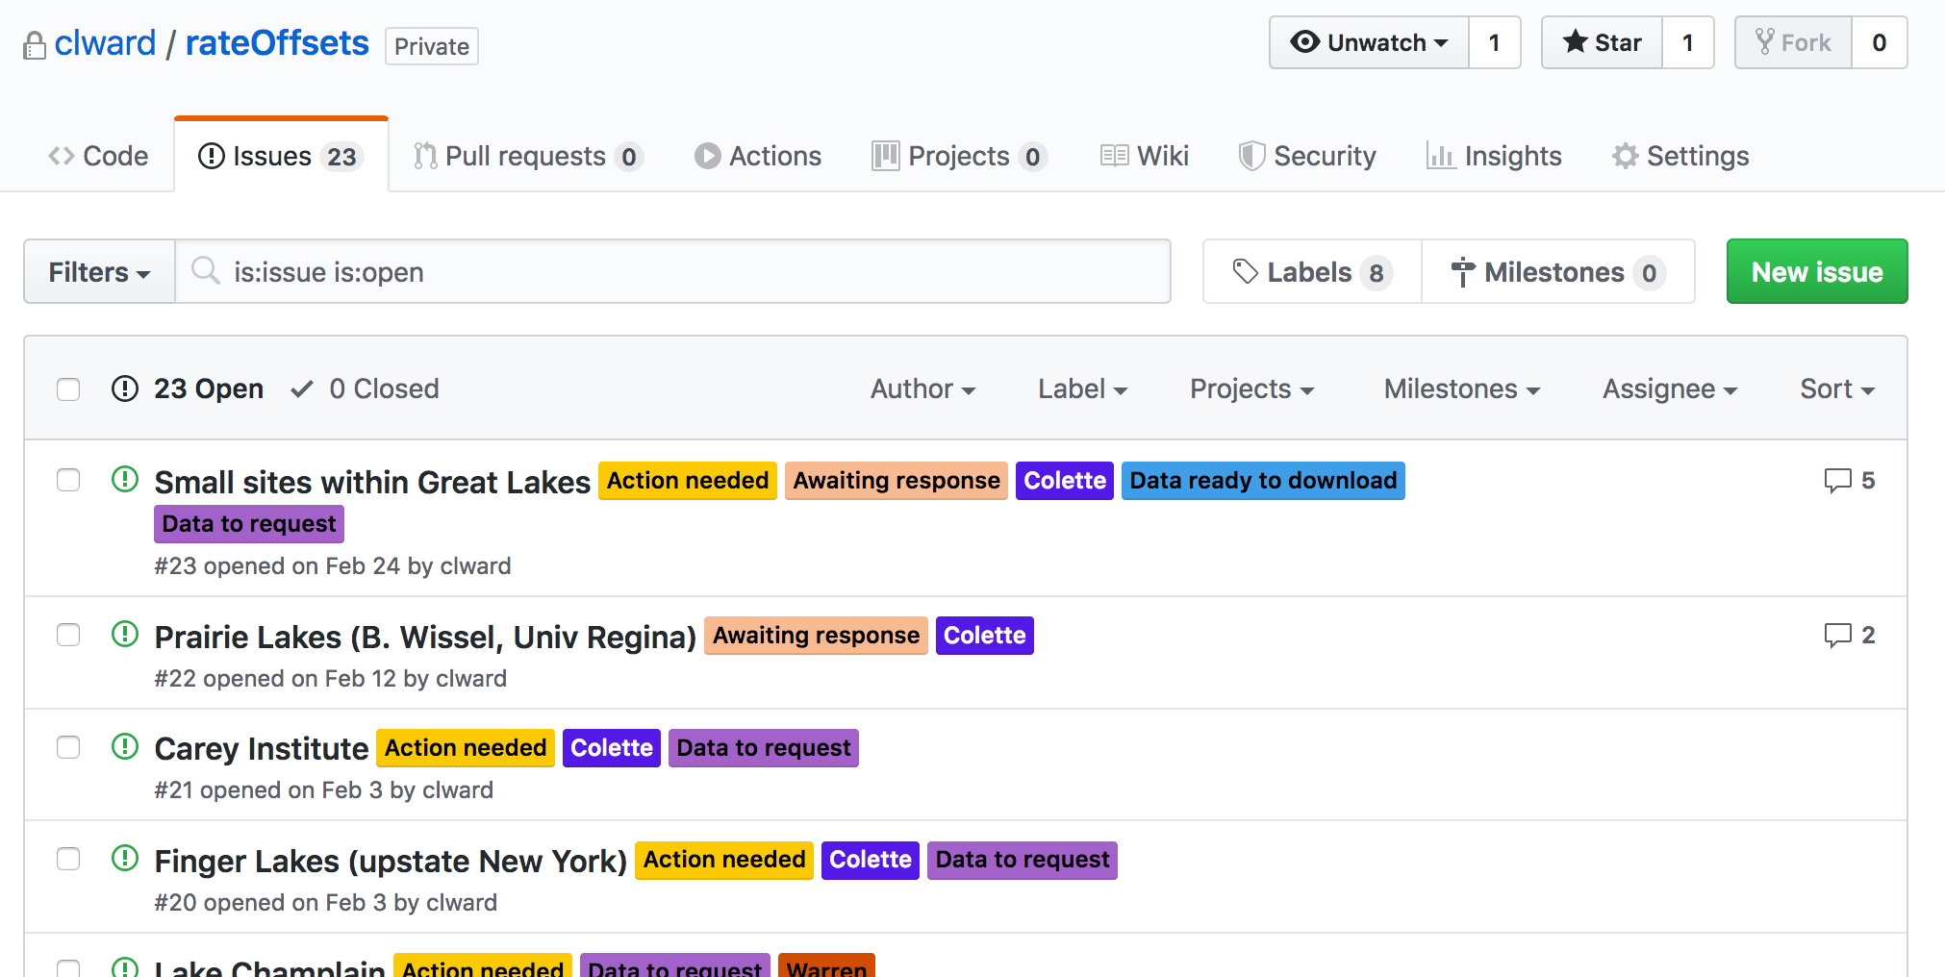
GitHub Issues: for bug reporting, project management, …
* Click on an issue to write comments. Recall that you can hyperlink to code lines!

Slide 51
Useful resources
Awesome comprehensive overview: https://happygitwithr.com/
Coles notes overviews: https://ourcodingclub.github.io/tutorials/git/ http://ohi-science.org/data-science-training/github.html#github
Doing it all in the terminal with the command line: https://rubygarage.org/blog/most-basic-git-commands-with-examples https://git-scm.com/docs

